Slide 1
Decision tree classification (id3)
M Parthasarathi Reddy

Slide 2
Outline
Decision Tree
Graphical Representation
What is ID3?
Steps involved in ID3 Algorithm
Entropy
Information Gain
Example for illustrate ID3 Algorithm on a data
Final desired tree for the given dataset
Characteristics of ID3 Algorithm

Slide 3
Decision Tree
A decision tree is a non-parametric supervised learning algorithm, which is utilized for both classification and regression tasks. It has a hierarchical, tree structure
The tree consists of decision nodes and leaf nodes.
A decision node is a point where a decision is made based on the values of specific input feature.
A leaf node attribute produces a homogeneous result (all in one class), which does not require additional classification testing.

Slide 4
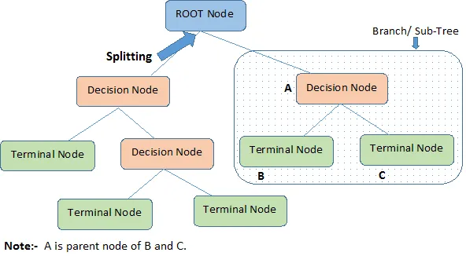
Graphical Representation

Slide 5
What is ID3 ?
In decision tree learning, ID3 (Iterative Dichotomiser 3) is an algorithm invented by Ross Quinlan in 1986 used to generate a decision tree from a dataset. ID3 is the precursor to the C4.5 algorithm, and is typically used in the machine learning.
ID3 decision tree algorithm uses Information Gain to decide the splitting points. In order to measure how much information we gain, we can use entropy to calculate the homogeneity of a sample. It uses a top-down greedy approach to build a decision tree.

Slide 6
Steps involved in ID3 Algorithm
1. Calculate entropy for dataset.
2. For each attribute/feature.
2.1. Calculate entropy for all its categorical values.
2.2. Calculate information gain for the feature.
3. Find the feature with maximum information gain.
4. Repeat it until we get the desired tree.

Slide 7

Entropy
In decision trees, entropy is a measure of impurity or uncertainty of the sample values. Value of Entropy always range between 0 to 1. It is defined with by the following formula,
$${S=\sum_{i=0}^{n}{p_{i}}log}_{2}{p_{i}}$$
where,
S = Entropy
$p_{i}$=probability of randomly selecting an example in class i.

Slide 8
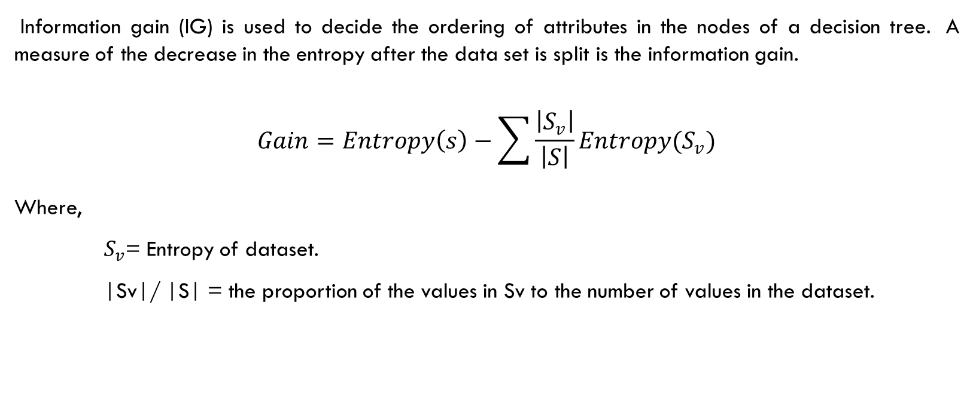
Information Gain
Information gain (IG) is used to decide the ordering of attributes in the nodes of a decision tree. A measure of the decrease in the entropy after the data set is split is the information gain.
$$Gain=Entropy\left(s\right)−\sum{\frac{\left|S_{v}\right|}{\left|S\right|}Entropy(S_{v})}$$
Where,
$S_{v}$= Entropy of dataset.
|Sv|/ |S| = the proportion of the values in Sv to the number of values in the dataset.

Slide 9
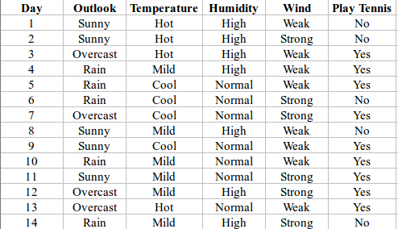
Example for Illustrate ID3 algorithm on a data

Slide 10
Here, dataset is of binary classes(yes and no), where 9 out of 14 are "yes" and 5 out of 14 are "no".
Complete entropy of dataset is:
H(S) = - p(yes) * log2(p(yes)) - p(no) * log2(p(no))
= - (9/14) * log2(9/14) - (5/14) * log2(5/14)
= - (-0.41) - (-0.53)
= 0.94

Slide 11
For each attribute of the dataset, let's follow the step-2
First Attribute – Outlook
Categorical values - sunny, overcast and rain
H(Outlook=sunny) = -(2/5)*log(2/5)-(3/5)*log(3/5) =0.971
H(Outlook=rain) = -(3/5)*log(3/5)-(2/5)*log(2/5) =0.971
H(Outlook=overcast) = -(4/4)*log(4/4)-0 = 0
Average Entropy Information for Outlook -
I(Outlook) = p(sunny) * H(Outlook=sunny) + p(rain) * H(Outlook=rain) + p(overcast) * H(Outlook=overcast)
= (5/14)*0.971 + (5/14)*0.971 + (4/14)*0
= 0.693
Information Gain = H(S) - I(Outlook)
= 0.94 - 0.693
= 0.24

Slide 12
Similarly, Do the same calculations for all the remaining attributes…They get :
Second Attribute – Temperature:
Information Gain(Temp)= 0.0292
Third Attribute – Humidity
Information Gain(H)= 0.153
Fourth Attribute – Wind
Information Gain(W)= 0.048

Slide 13
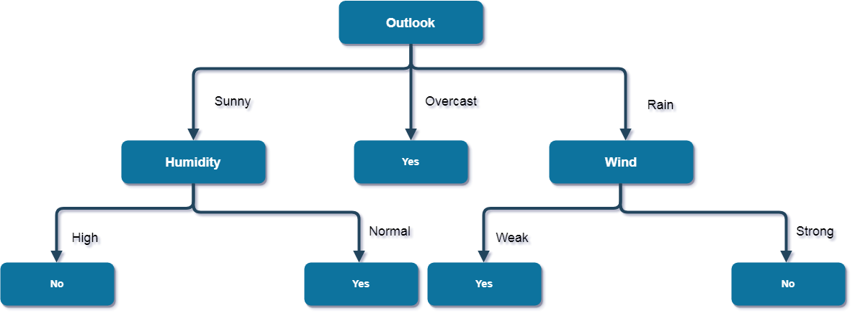
Final desired tree for the given dataset

Slide 14
Hyperparameters
Maximum Depth: This hyperparameter limits the maximum depth of the decision tree that can be built. It is set to prevent overfitting and to control the complexity of the resulting tree.
Minimum Samples Split: This hyperparameter sets the minimum number of samples required to split an internal node. It is used to prevent the algorithm from splitting a node that has too few samples, which could lead to overfitting.

Slide 15
Minimum Information Gain: This hyperparameter sets the minimum threshold for the information gain measure. If the information gain for an attribute is less than this threshold, the attribute will not be considered for splitting the node. It is used to prevent the algorithm from creating nodes that do not contribute much to the overall classification accuracy.
Pruning: This hyperparameter controls whether or not to use a pruning technique to reduce the size of the decision tree. Pruning removes unnecessary branches from the tree, which reduces the risk of overfitting and improves the generalization performance of the tree.

Slide 16
Characteristics of ID3 Algorithm
ID3 uses a greedy approach that's why it does not guarantee an optimal solution.
ID3 can overfit to the training data (to avoid overfitting, smaller decision trees should be preferred over larger ones).
This algorithm usually produces small trees, but it does not always produce the smallest possible tree.
ID3 is harder to use on continuous data (if the values of any given attribute is continuous, then there are many more places to split the data on this attribute, and searching for the best value to split by can be time consuming).

Slide 17
Advantages of ID3
Extremely fast at classifying unknown records Easy to interpret for small-sized trees.
Robust to noise (especially when methods to avoid over-fitting are employed)
Builds the fastest tree.
Builds a short tree.
Only need to test enough attributes until all data is classified.
Finding leaf nodes enables test data to be pruned, reducing number of tests.
Whole dataset is searched to create tree.

Slide 18
Disadvantages of ID3
ID3 is harder to use on continuous data (if the values of any given attribute is continuous, then there are many more places to split the data on this attribute, and searching for the best value to split by can be time consuming).
ID3 can overfit to the training data (to avoid overfitting, smaller decision trees should be preferred over larger ones).

Slide 19
Thank You :)

